Slide 1



Slide 2
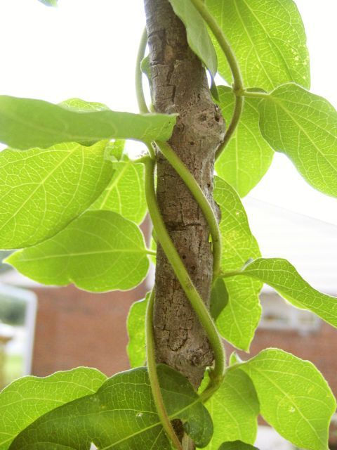
LESSON 1.
GASEOUS EXCHANGE IN PLANTS

Slide 3
POINTS TO PONDER
Gaseous exchange
Breathing
Respiration
Gaseous exchange in plants

Slide 4
INTRODUCTION
Difference between gaseous exchange, breathing and respiration;
Gaseous exchange:
Diffusion of gases from region of higher concentration to region of lower concentration
Intake of oxygen and giving out of Carbon dioxide by organism to the outside environment e.g., plants and animals

Slide 5
Breathing:
Mechanical or physical process for exchange of gases
Inhalation and exhalation of air
Respiration
Mechanical and biochemical process
Oxidation reduction reactions
Break down of food with the help of oxygen (Aerobic respiration)
Release of energy in the form of ATP

Slide 6
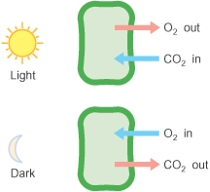
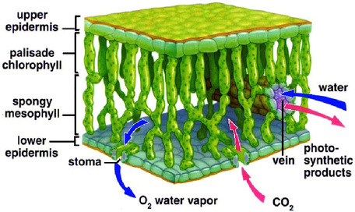
GASEOUS EXCHANGE IN PLANTS
Gaseous exchange day vs. night
Internal structure of leaf

Slide 7

GASEOUS EXCHANGE IN PLANTS

Slide 8
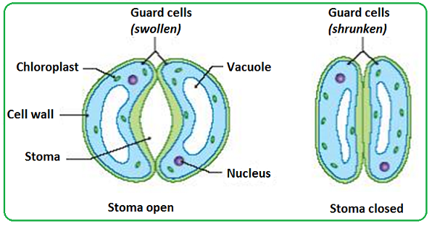
GASEOUS EXCHANGE IN PLANTS
No special respiratory organs e.g., lungs or gills
Large surface area compared to volume for exchange of gases by diffusion
Structures involved for exchange of gases in terrestrial plants
Stomata and spaces among mesophyll cells:
Hole like structures present in epidermis of leaves and young stems………stomata
Exchange of gases and water vapors

Slide 9
Two situations in leaf;
Day time:
Photosynthesis and respiration side by side
Oxygen produced in photosynthesis….used in cellular respiration
Carbon dioxide produced in cellular respiration….used in photosynthesis
2. Night time:
No photosynthesis only respiration
Cells get oxygen from the environment
Release carbon dioxide to the outside environment

Slide 10
Lenticels:
Stems
Covered by bark
Impervious to gases
Have small scars with small holes other than stomata, called lenticels..
Allow air to pass through, from environment to internal tissues
Roots:
Get dissolved oxygen from soil water by diffusion

Slide 11
THANK YOU

Slide 12


